Slide 1

Managing Data Quality in OpenStreetMap
Tools for an active mapping community
NC GIS Conference 2013
This document licensed in entirety by Creative Commons CC-by-SA. For specific terms of license, see: http://creativecommons.org/licenses/by-sa/3.0/

Slide 2
Overview
2
The Short History of the OpenStreetMap Revolution
Assessing Open Source Data Quality
Overview of Tools
Creating Tools that Matter

Slide 3
Overview: Key Questions
How can crowd-sourced projects manage data quality effectively?
What tools exist for monitoring data quality in OpenStreetMap?
What conclusions can be drawn about existing tools?
What is the future of data quality in crowd-sourced projects?

Slide 4
OpenStreetMap is…
4
A freely-editable map of the world unconstrained by proprietary ownership
“Wikipedia for maps”

Slide 5
The Origins of OpenStreetMap
5
OpenStreetMap.org domain registered by Steve Coast in 2004
Project originated in the United Kingdom, where…
Crown copyright on geospatial data
Little, or no public domain data
Simple goal to create a free, publicly-available database of street centerlines

Slide 6
OpenStreetMap is…
6
A freely-editable map of the world unconstrained by proprietary ownership
“Wikipedia for maps”

Slide 7
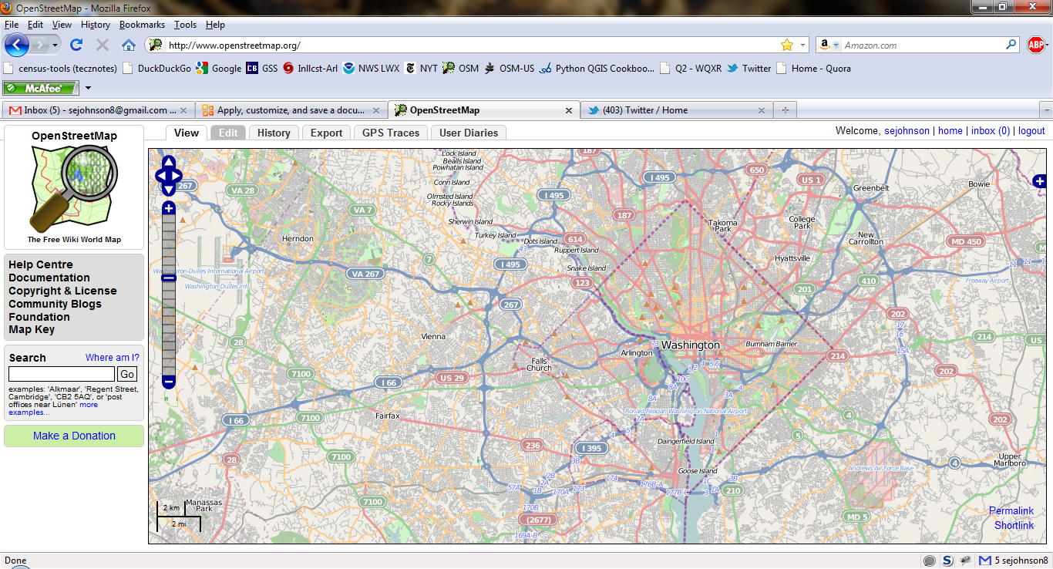
Looks like…a wiki
7

Slide 8
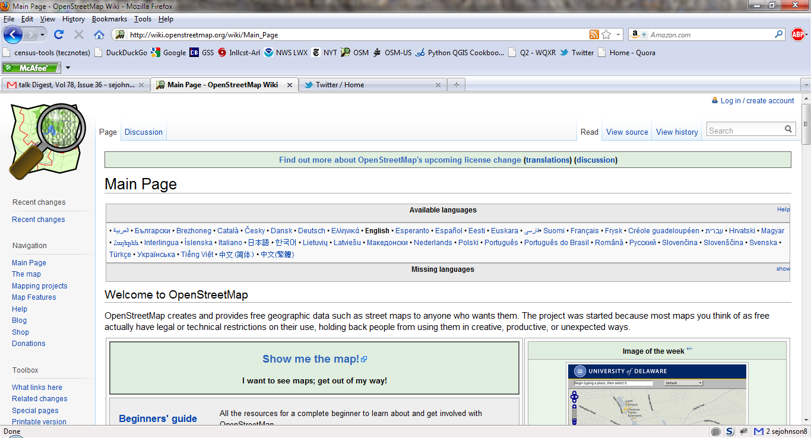
Wiki-based Documentation!
8

Slide 9
Milestones in OpenStreetMap History
9
2004 - OpenStreetMap.org registered by Steve Coast
2005 – Map Limehouse, 1st OpenStreetMap mapping party
2005 – 1000 registered OpenStreetMap users
2006 – OpenStreetMap Foundation established
2007 – 5 million ways in OSM database
2007 – 10,000 registered OpenStreetMap users
2008 - TIGER data import for the US completed
2009 - 100,000 registered OpenStreetMap users
2010 - 200,000 registered OpenStreetMap users
2012 – ~670,000 registered OpenStreetMap users

Slide 10
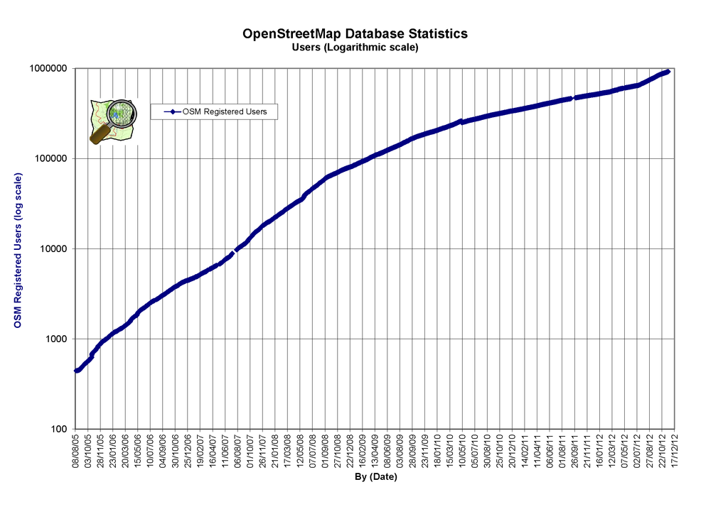
OpenStreetMap User Growth
10
One million registered users worldwide!

Slide 11
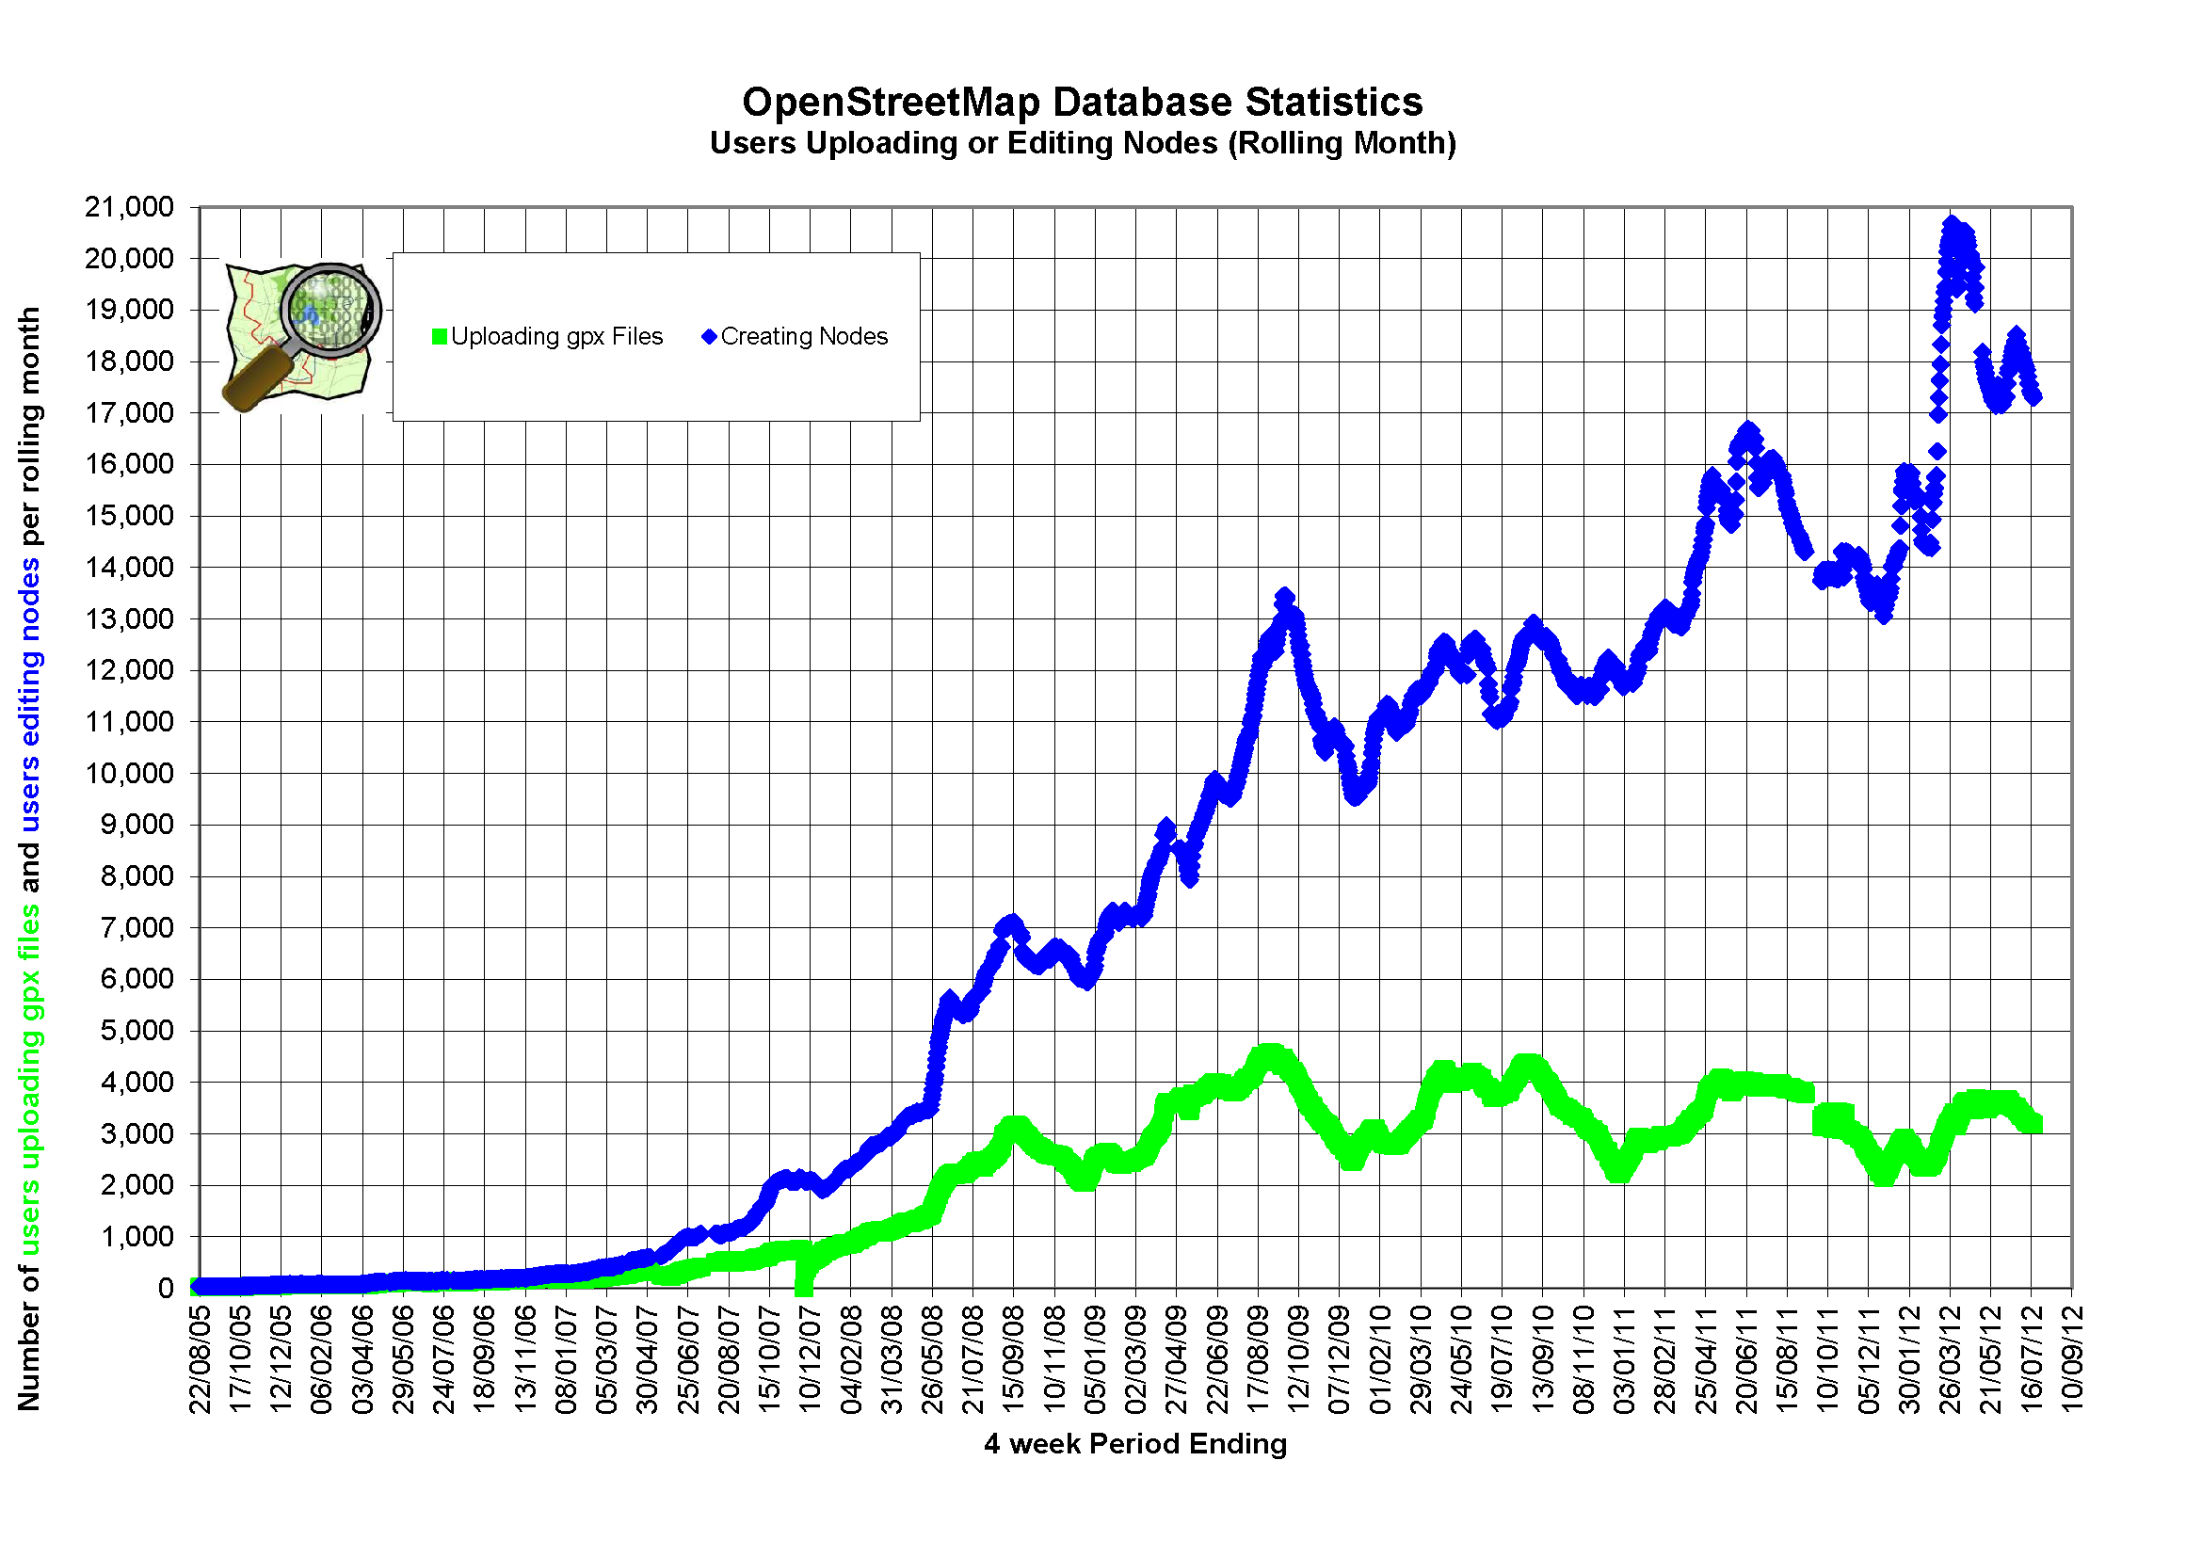
OpenStreetMap Growth in User Edits

Slide 12
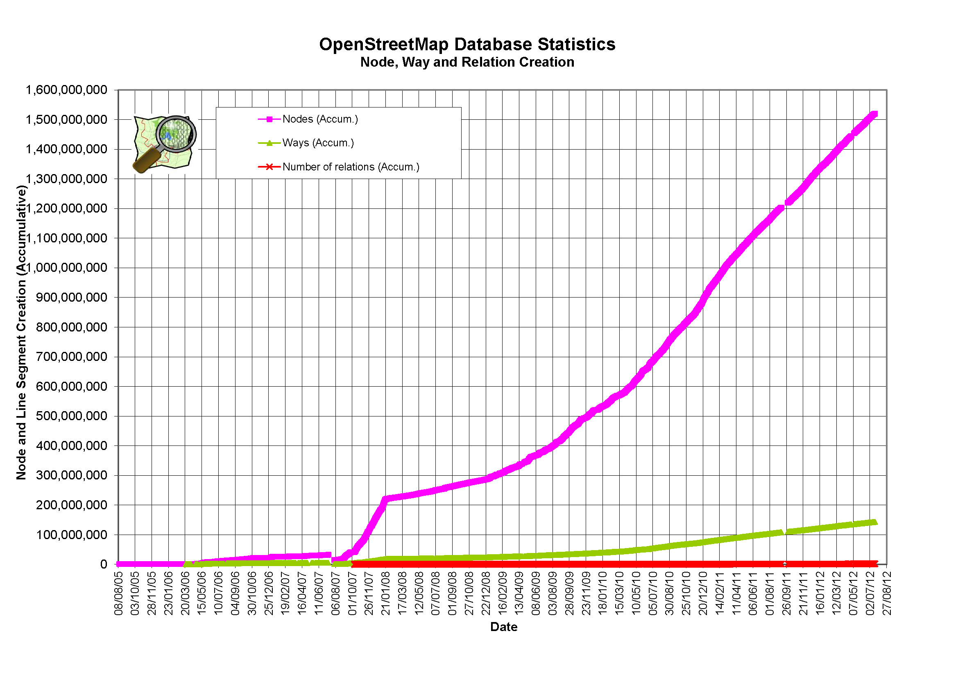
OpenStreetMap Database Growth
12

Slide 13
Data Quality in Crowd-sourced Projects
Goodchild & Li: Identified three mechanisms for Quality Assurance
Crowd-sourcing
Social
Geographic
Goodchild, Michael F., and Linna Li. "Assuring the quality of volunteered geographic information."
Spatial Statistics 1 (2012): 110-120.

Slide 14
Crowd-sourced Approach to Data Quality
Based on Surowiecki’s “Wisdom of the Crowd”
Multiple users converge around consensus solutions that might escape an individual
Many independent observations reinforce the validity of a single observation
Concurrence on observed features (e.g. “It’s a bridge.”)
Convergence on the truth
The group validates observations & corrects errors
Surowiecki, J., 2005. The Wisdom of Crowds. Anchor, New York.

Slide 15
Social Approach to Data Quality
Through practices, users acquire reputations
Users with good reputations are trusted
Trust and reputation are indicators of stewardship
As the project evolves, social leadership becomes more formalized.
The Data Working Group of OpenStreetMap fullfills this function
Email lists supplement social stewardship

Slide 16
Geographic Tools for Data Quality
Geographic approach draws on formal geographic theory:
Spatial neighbors & auto-correlation (Moran statistics)
Christaller’s Central Place Theory
Descriptive Statistics
Inferential Statistics & Analysis of Variance (ANOVA)
Richardson plots of linear measurements
Cluster analysis, e.g. k-means
These approaches have not been widely adopted for use in the OpenStreetMap project…yet

Slide 17
A Quick Survey of Data Quality Tools
Two types of tools are in widespread use:
Error Detection Tools
Monitoring Tools

Slide 18
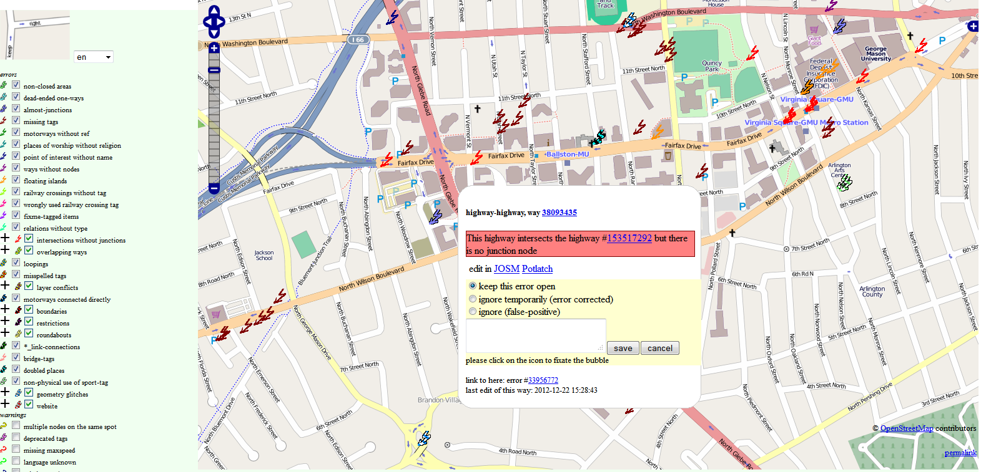
Error Detection Tools: Keep Right

Slide 19
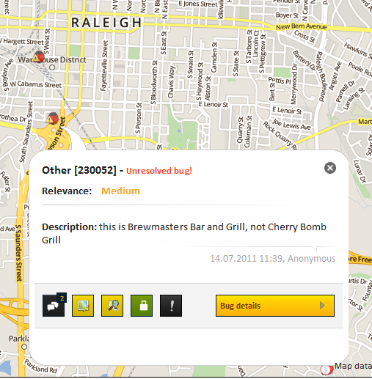
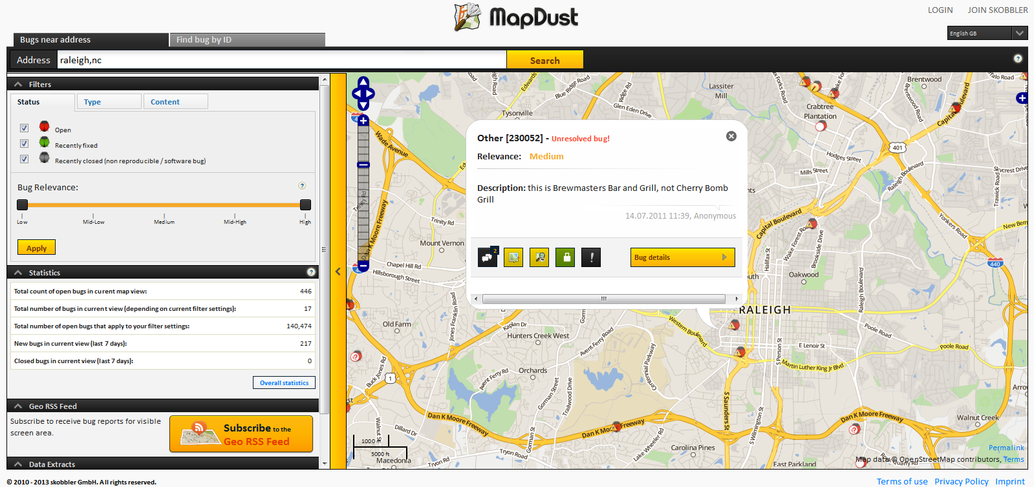
Error Detection Tools: Map Dust

Slide 20
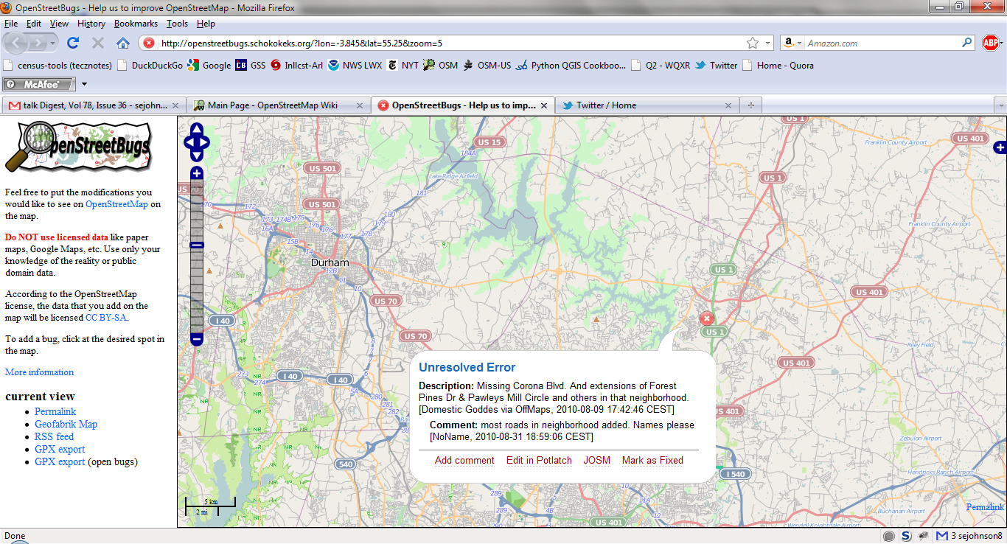
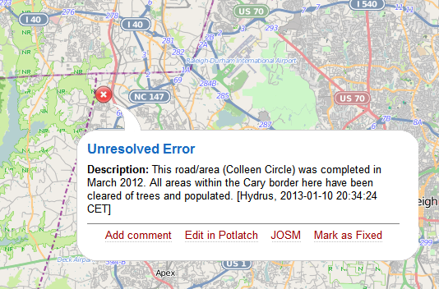
Error Detection Tools: OpenStreetBugs

Slide 21
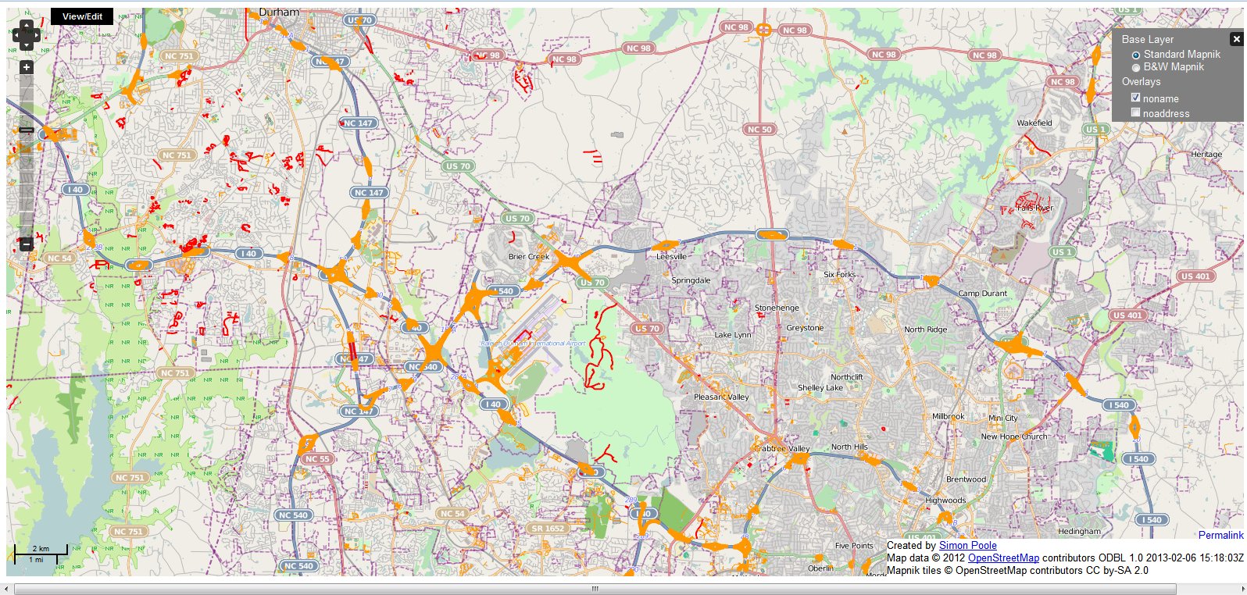
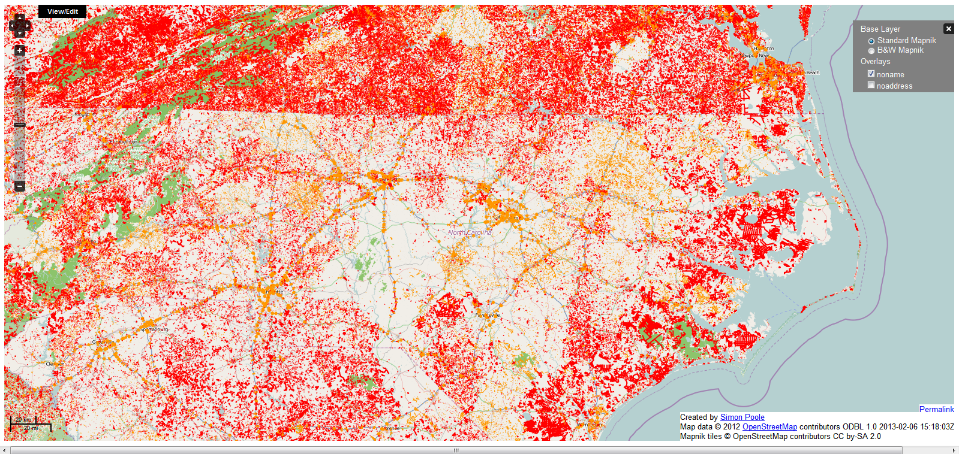
Error Detection Tools: No Name

Slide 22
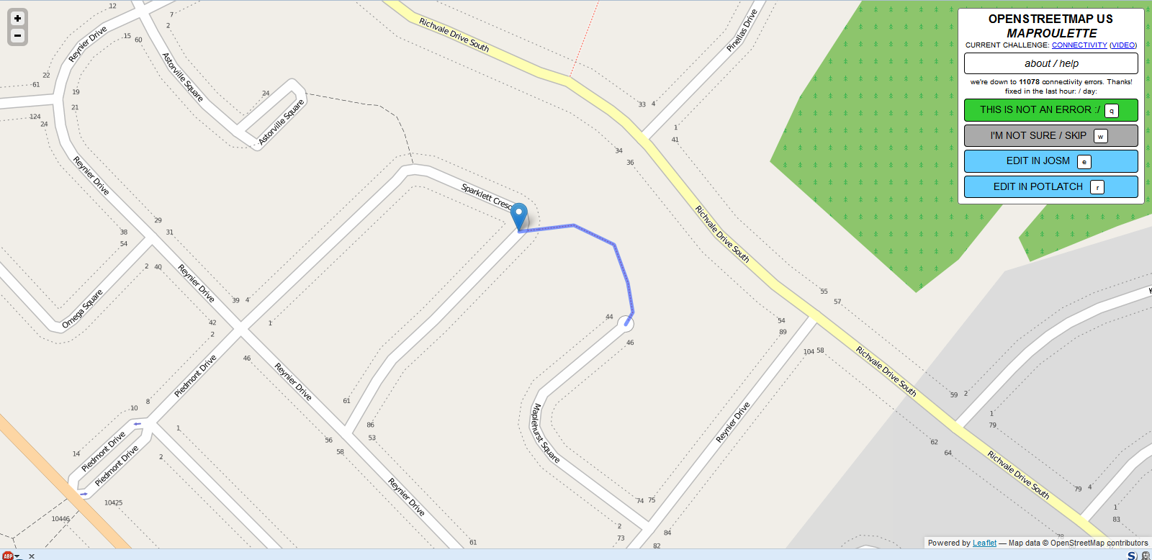
Error Detection Tools: MapRoulette

Slide 23
Monitoring Tools

Slide 24
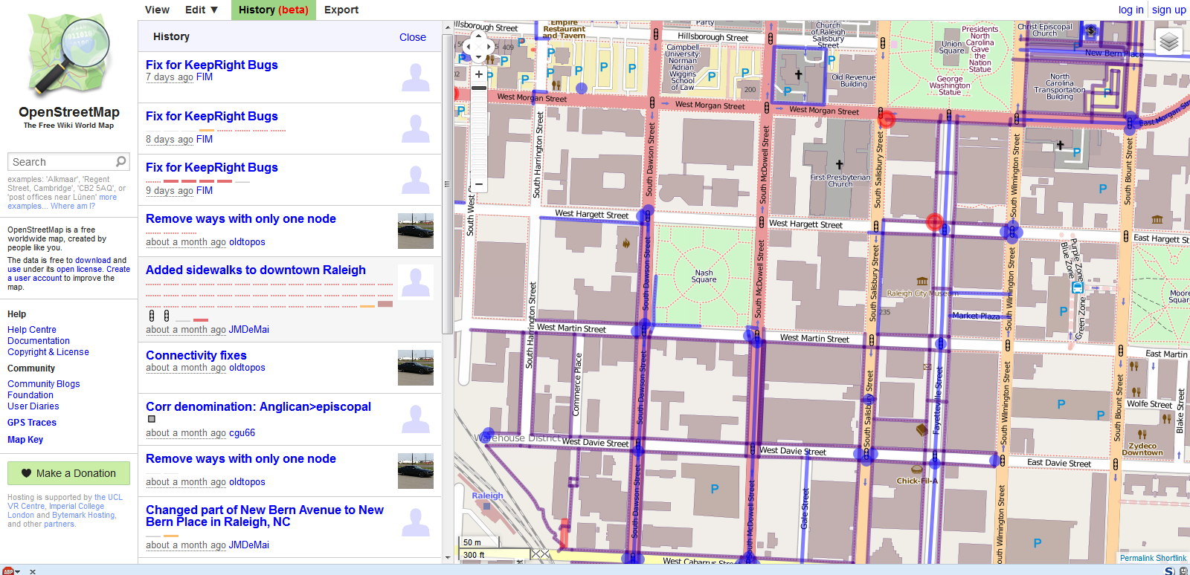
Monitoring Tools: OpenStreetMap Watch List (OWL)

Slide 25
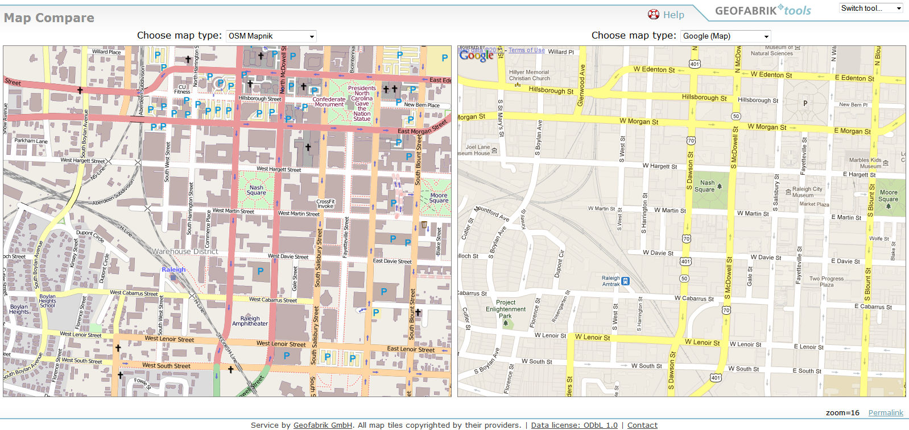
Monitoring Tools: GeoFabrik Map Compare

Slide 26
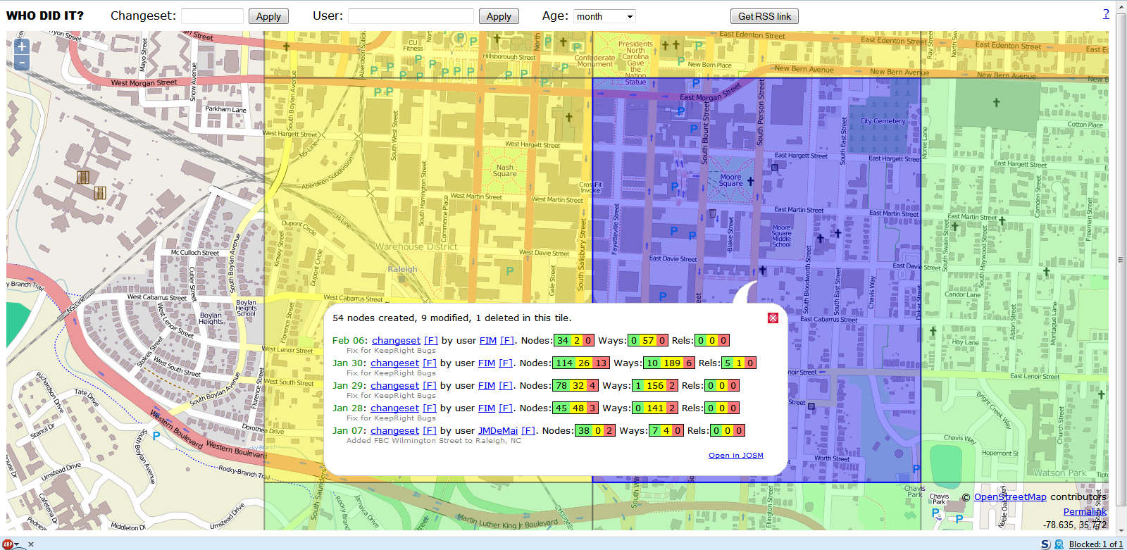
Monitoring Tools: Who Did It

Slide 27
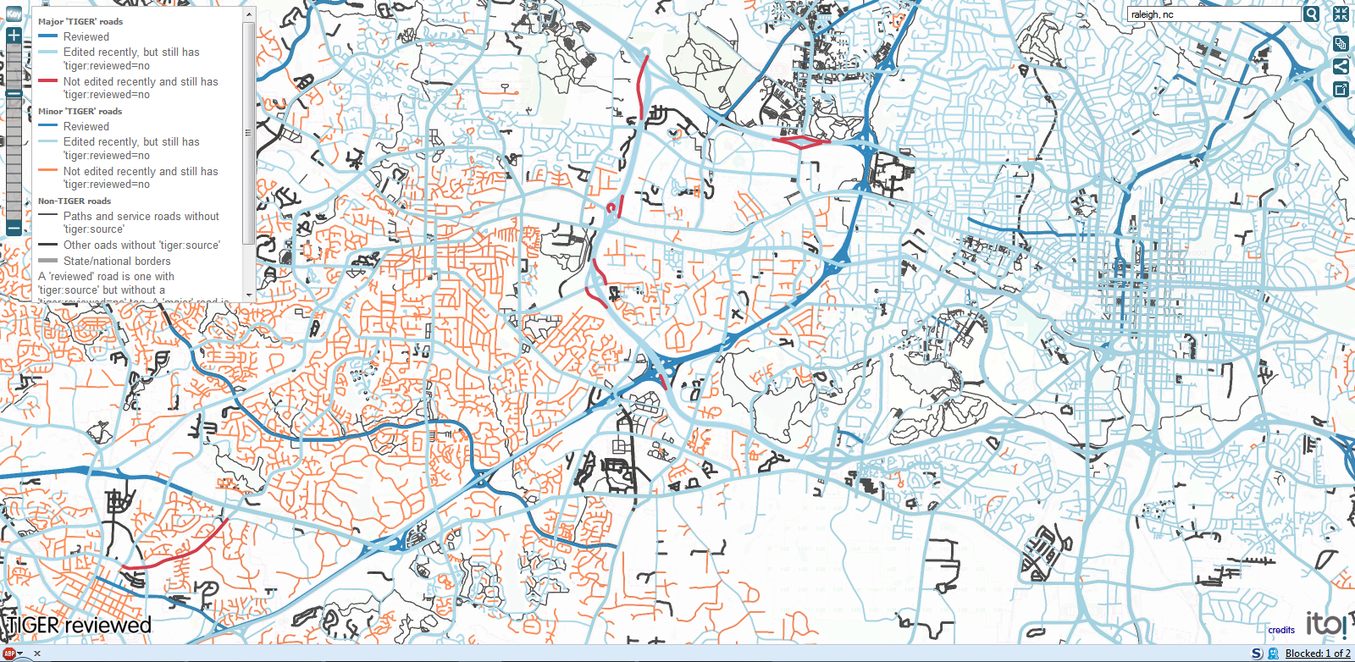
Monitoring Tools: ITO TIGER Reviewed

Slide 28
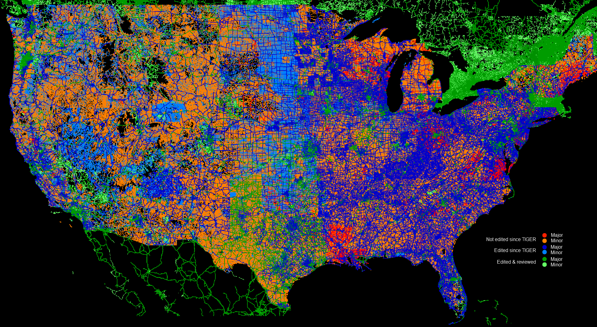
Monitoring Tools: ITO TIGER Reviewed

Slide 29
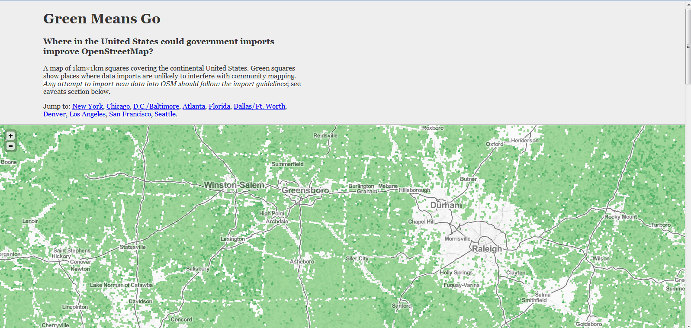
Monitoring Tools: Green Means Go

Slide 30
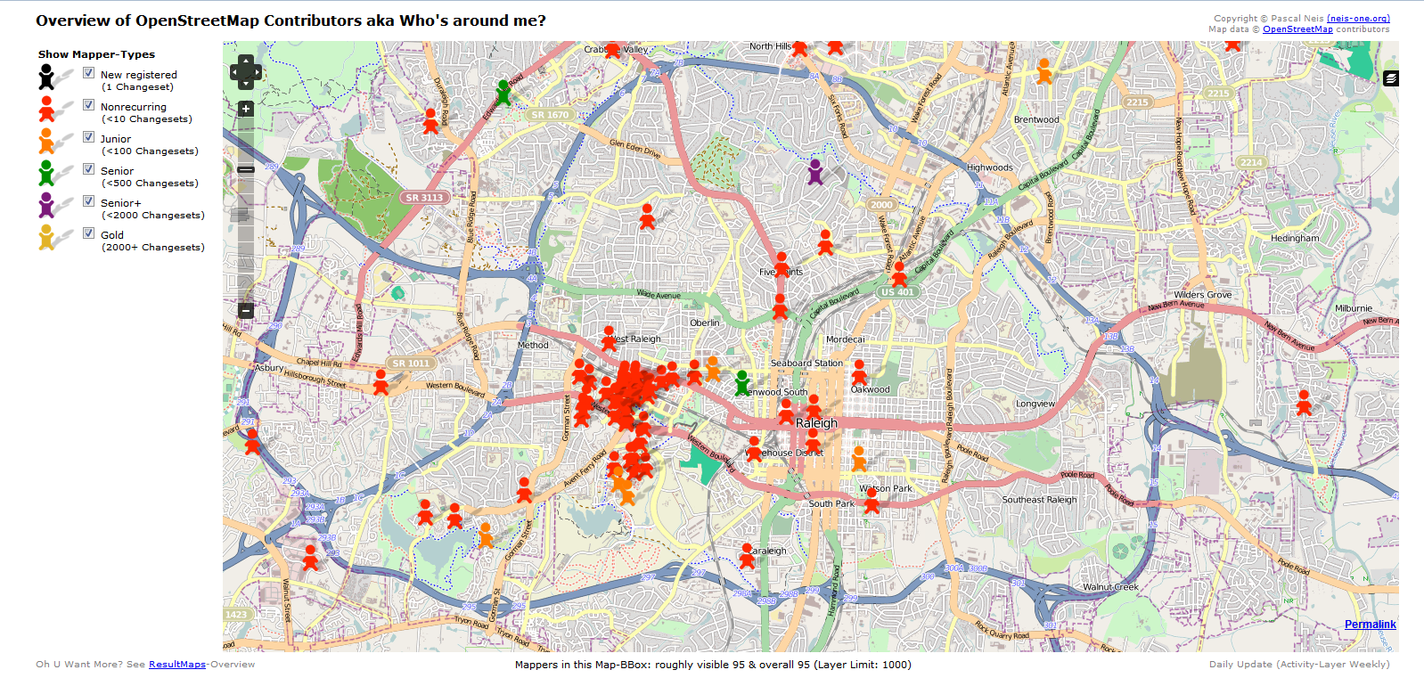
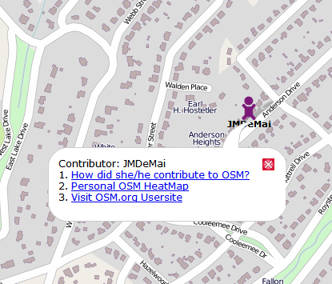
Monitoring Tools: Who’s Around Me

Slide 31
Social Controls
OpenStreetMap - Data Working Group (DWG)
Resolving disputes between users
Processes & protocols for data imports
Investigates copyright infringement
Deals with issues of vandalism and fraud
Suspends or closes user accounts (in case of abuse)
IP blocking (in case of abuse)

Slide 32
How do Social Methods Treat Vandalism?
OpenStreetMap is not immune from malicious intent
Copyright infringement (e.g. copying from Google Maps)
Graffiti
Disputes & “Edit Wars” (e.g. Kashmir region, Palestine)
Spam
Tools for Managing Vandalism
Detect using daily diffs
UserActivity – batch comparison of two versions of the database
Revert – undo changeset to previous version
Virtual Ban

Slide 33
Summary Review
Three methods for data quality control
Crowd-sourced
Social
Geographic
OpenStreetMap has crowd-sourced and social tools for managing data quality
Error & Monitoring tools
Data Working Group - Social
Geographic methods are experimental at this time
Increasingly complete geographic features will lead to better tools

Slide 34
Lessons Learned about OSM Data Quality
Successive editing by multiple users can improve accuracy…up to a point
Haklay suggests that few improvements are made beyond the 13th edit
Semantic differences are not easy to resolve – “Tag wars”
Obscure edits do not always get corrected if there are no local mappers that take ownership
Social approaches will acquire more authority
Are part-time, volunteer staffers enough to guarantee data quality?
What are appropriate metrics for trust and reputation?
Haklay, M. 2010. How Good is volunteered geographical information? a comparative study of OpenStreetMap and Ordnance Survey Datasets. Environment & Planning B: Planning and Design 37 (4), 682-703g

Slide 35
Thank You
Questions?
Steven Johnson
(e) stevejohnson@deloitte.com
(t) @geomantic
This document licensed in entirety by Creative Commons CC-by-SA. For specific terms of license, see: http://creativecommons.org/licenses/by-sa/3.0/

